Slide 1
Mood Boards and the Collective Unconscious
Matthias RAUTERBERG
Department of Industrial Design
Eindhoven University of Technology
The Netherlands

Slide 2
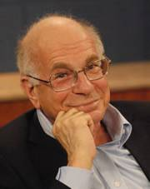
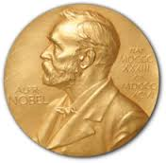
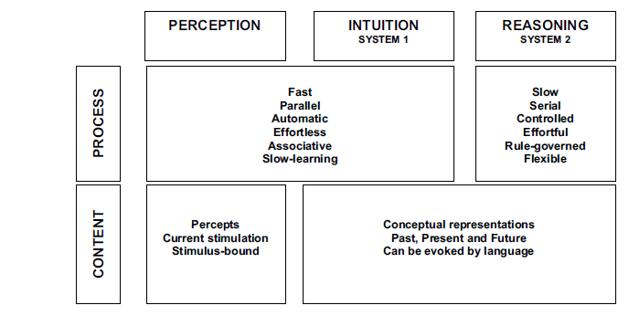
Daniel KAHNEMAN Map of Bounded Rationality: A Perspective on Intuitive Judgement and Choice .
Nobel Prize, 8 December 2002
REF: Kahneman, D. (2003). Maps of bounded rationality: A perspective on intuitive judgment and choice. In T. Frangsmyr (Ed.), Les Prix Nobel 2002 [Nobel Prizes 2002]. Stockholm, Sweden: Almquist & Wiksell International. Note that this chapter has two sections: the first is an autobiography (with a eulogy for Amos Tversky), and the second is a transcript of his Nobel lecture, which is what the title refers to. The autobiographical portion has been republished as: Kahneman, D. (2007). Daniel Kahneman. In G. Lindzey & W.M. Runyan (Eds.), A History of Psychology in Autobiography, Volume IX (pp. 155–197). Washington, DC: American Psychological Association.

Slide 3
consciousness * propositional representation * synchronization via global workspace
verbal behaviour
phenomenal consciousness * internal processing
multi modal actuator output
nonverbal behaviour
unconsciousness * parallel processing in modular subsystems
multi modal sensory input
REF: Hofmann W., Wilson T. (2010). Consciousness, introspection, and the adaptive unconscious. In: B. Gawronski & B. K. Payne (Eds.), Handbook of Implicit Social Cognition: Measurement, Theory, and Applications (pp. 197-215). New York: Guilford Press.

Slide 4
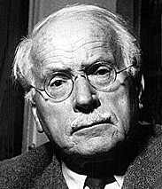
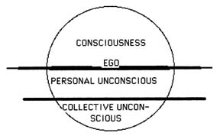
(1875-1961)
After 1910 the discoveries of
Carl Gustav JUNG
about the collective unconscious and the related archetypes were challenging. Jung dreamt a great deal about the dead, the land of the dead, and the rising of the dead. These represented the unconscious itself -- not the "little" personal unconscious that Freud made such a big deal out of, but a new collective unconscious of humanity itself, an unconscious that could contain all the dead, not just our personal ghosts. Jung began to see the mentally ill as people who are haunted by these ghosts, in an age where no-one is supposed to even believe in them. If we could only recapture our mythologies, we would understand these ghosts, become comfortable with the dead, and heal our mental illnesses.

Slide 5
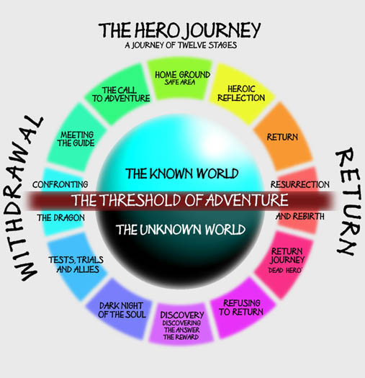
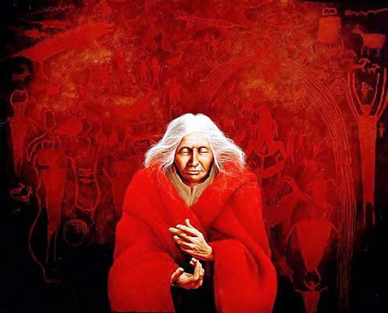
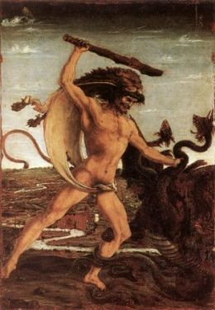
REF: Campbell J. (1949/2008). The hero with a thousand faces. Princeton University Press.

Slide 6
Do archetypes have an effect on humans?
A collaborative project between two PhD students
Leonid IVONIN
Shared activities
Huang-Ming CHANG
Processing of physiological signals and application of data mining methods
Development of technical infrastructure for the experiments
Sensing application (ArcheSense)
Generation of ideas
Statistical analysis
Writing of articles
Identification, selection, and preparation of audiovisual stimuli for elicitation of psychological states
Selection of appropriate questionnaires
Moodboard application (ArcheBoard)
REF: Ivonin L., Chang HM., Díaz M., Català A., Chen W., Rauterberg M. (2015). Traces of unconscious mental processes in introspective reports and physiological responses. PLOS ONE, vol. 10, no. 4, e0124519 (April 13, 2015), pp. 1-31. (online). [IF=3.197]

Slide 7
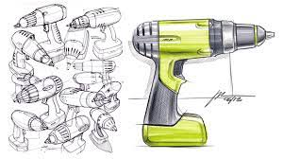
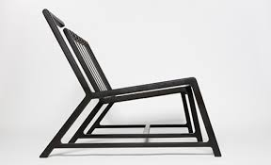
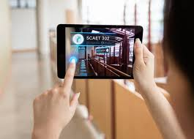
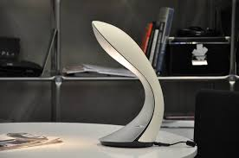
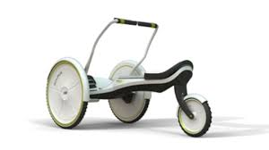
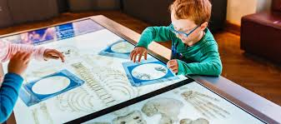
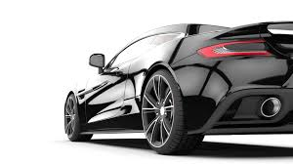
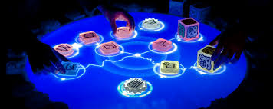
From
Industrial Design
To
Interaction Design
from UI to UX

Slide 8
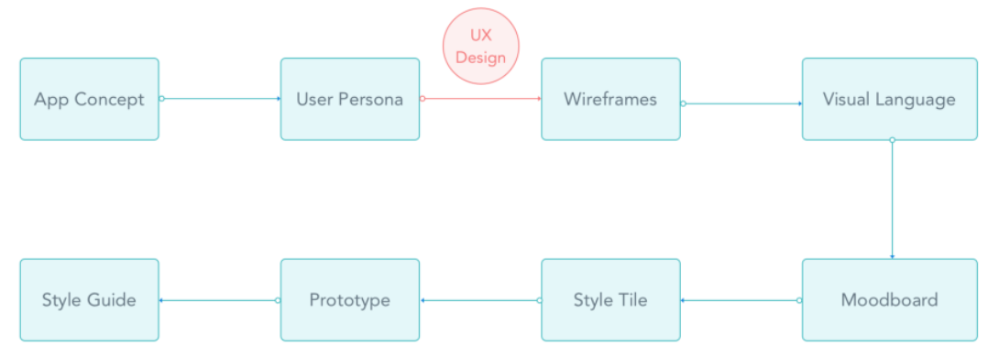
Big Question:
How to improve the design of product/service systems?

Slide 9
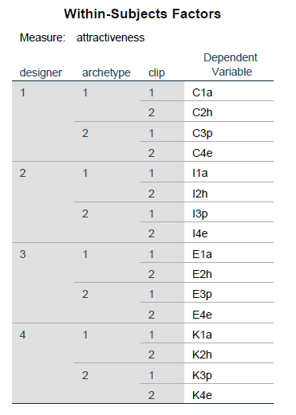
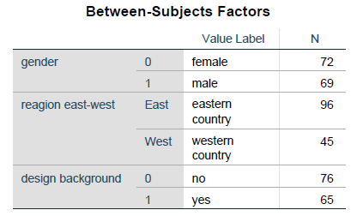
Approach:
N=4 professional designers (C, I, E, K) were primed with 4 TV commercials and created for each commercial a mood-board (4*4=16 mood-boards)
N=141 students worldwide rated and ranked all 16 mood-boards 72 female, 69 male (age 29±8 years; 28 nationalities)
96 from Eastern countries, 45 from Western countries 65 design students, 76 non-design students
Dependent Variable: all students rated all mood-boards online on an attractiveness ranking scale [1-100]
1=C
2=I
3=E
4=K
1=yes
2=no
a=anima
h=hero
p=parts
e=everyday

Slide 10
Clip-parts
Clip-anima
Clip-everyday
Clip-hero

Slide 11
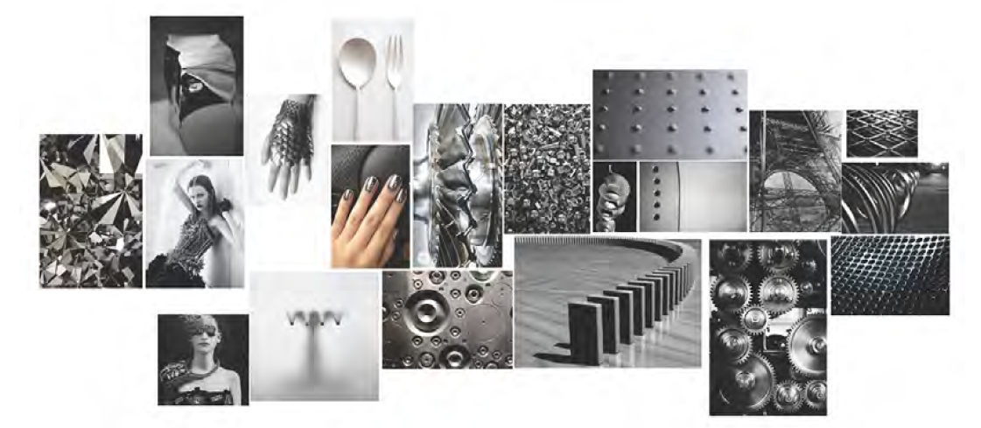
Top-ranked mood-board: parts
Top-ranked mood-board: everyday

Slide 12
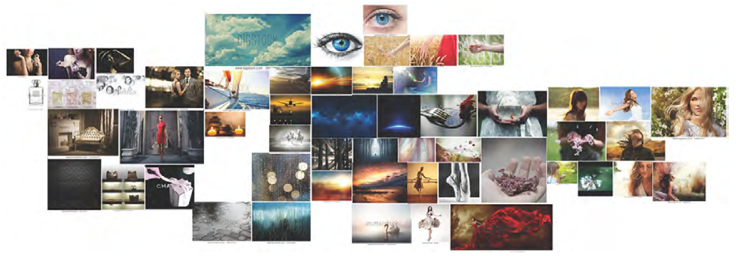
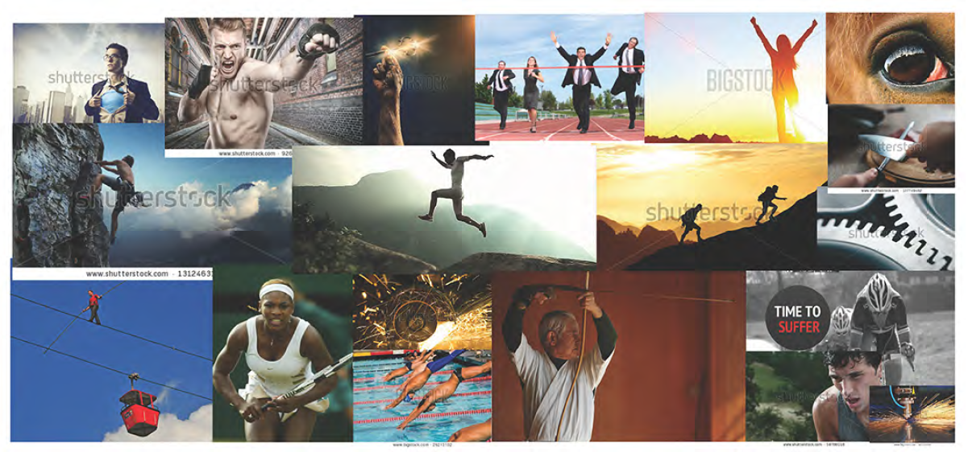
Top-ranked mood-board: anima
Top-ranked mood-board: hero

Slide 13
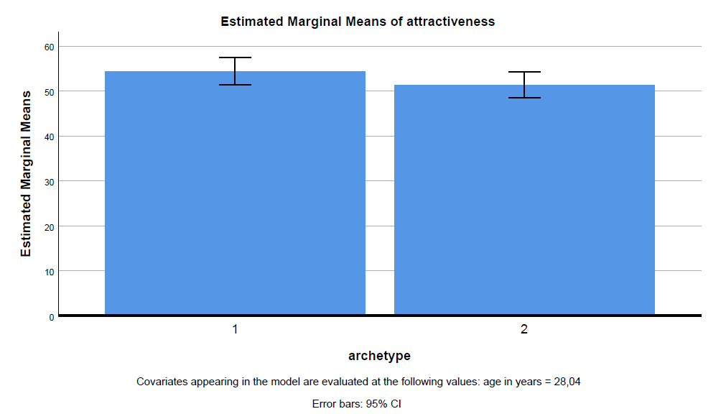
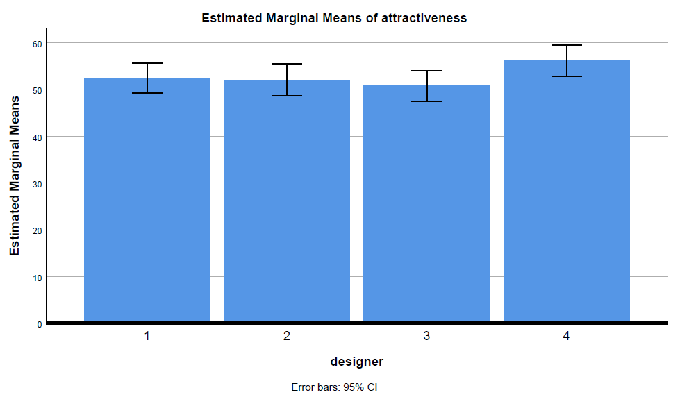
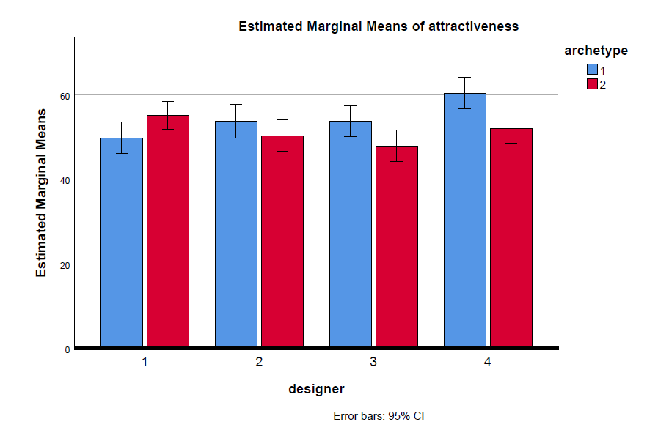
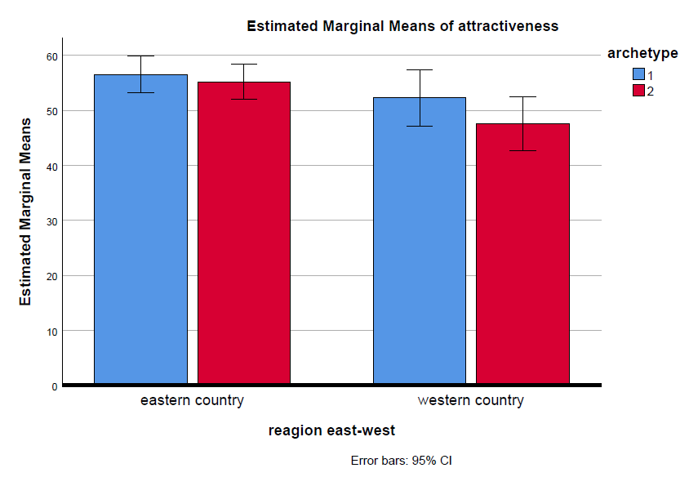
p<0.001
p<0.049
p<0.024
p<0.001
p<0.018
p<0.001
REF: Huang Ming CHANG (2014). Emotions in archetypal media content. PhD Thesis, Eindhoven University of Technology & Universitat Politècnica de Catalunya.

Slide 14
Conclusions
Priming with archetypal input increases attractiveness of mood boards
Different designers reacts differently to archetypal priming
Eastern countries are less sensitive to archetypal based mood-boards

Slide 15
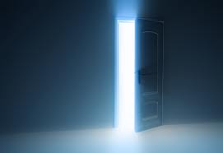
Thank you for your attention.
A door opens for new design challenges…
© 2020
Culture and Computing
8th International Conference, C&C 2020, Held as Part of the 22nd HCI International Conference, HCII 2020, Copenhagen, Denmark, July 19–24, 2020, Proceedings
Editors: Rauterberg, Matthias (Ed.)

